Slide 1

CSI week of 11/18: Open Enrollment – 2024 Part 4
Welcome to Open Enrollment for the 2025 coverage year.

Slide 2

Agenda
Standard Plans
MDLive Expansion
MG/PCP Changes
Locating ID Card Information
Address Updates
AutoDraft

Slide 3

Standard Plans

Slide 4

Standard Plans
Overview
Standard (or Standardized) plans were first introduced for the 2023 plan year as part of an initiative by CMS where all QHP (Qualified Health Plan) insurance carriers are required to offer standardized plans both On and Off Exchange.
The Standard plans are required by the Federal Marketplace and will be offered in Illinois, Montana, Oklahoma and Texas both On and Off-Exchange.
The Standard Plans are NOT being offered in New Mexico and are not required by BeWellNM.
All standard plans, within a given metallic level, are required to have the same:
Actuarial Value (Specific to Silver On Exchange Plans)
Max Out of Pocket Cost
Deductible
Cost Sharing
Number of Rx Tiers (4)
The Standard Plans are easily identified for 2025 because they have the word Standard in the plan name.
Example: Blue Choice Preferred Bronze PPO Standard - Rx Copays
Notes:
Click for Animations...

Slide 5

Standard QHP plans
Key Difference
The key difference between standard and non-standard plans is the Rx coverage. Standard plans only have 4 drug tiers where the non-standard plans have 6 drug tiers.
But regardless of the number of drug tiers, all QHP plans have the same drugs in their formulary lists.
This is how the drug tiers compare between the Standard and Non-Standard plans.
Non-Standard (6 Tier) Drug Plans
Standard (4 Tier) Drug Plans
Tier 1: Generic Preferred
Tire 2: Generic Non-Preferred
Tier 1: Generic
Tier 3: Brand Preferred
Tier 2: Brand Preferred
Tier 4: Brand Non-Preferred
Tier 3: Brand Non-Preferred
Tier 5: Specialty Preferred
Tire 6: Specialty Non-Preferred
Tier 4: Specialty
Reminder: Standard QHP Plans are NOT being offered in New Mexico (On or Off Exchange).
Notes:
Click for Animations, some Animations drive themselves...

Slide 6
MDLive Expansion

Slide 7
MDLive Expansion
MDLive Access
MDLIVE’s virtual benefit suite (Virtual Primary Care, Urgent Care, Behavioral Health, and Dermatology) is expanding to the new IL MyBlue Plus POS plan and the MT Blue Focus Care POS plan for 2025.
The MDLIVE Virtual Care suite offers members in hard to reach and remote areas an opportunity to receive care and enhance access for members.
Members will be allowed to select a virtual MDLIVE PCP as their Primary Care Physician via a robust Virtual Care option (reduced travel and wait times, remote care options, etc.).
Notes:
Click for Animations, some Animations drive themselves...

Slide 8
MG/PCP Changes

Slide 9
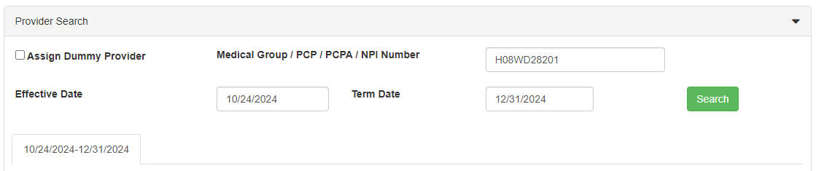
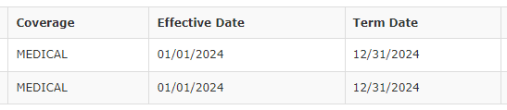
MG/PCP Changes
Reminder about Term Date
Whenever a policy has a future Term date, especially during OE, there is a slightly different process that must be followed when updating a MG or PCP for a member - the PCP Term Date must also be updated.
When updating a MG or PCP in ACE, the system will automatically set the PCP Term date to match the Policy Term date – so there is nothing special that you need to do in ACE.
However, in situations where the MG or PCP update must be done in RPI, you must remember to set the PCP Term Date to match the Policy Term Date.
This will ensure that the PCP updates correctly in the system and the ID Cards are correctly generated.
Notes:
Click for Animations, some Animations drive themselves...

Slide 10
MG/PCP Changes
IL MyBlue Plus POS
During CSI the week of 11/04, we introduced the IL MyBlue Plus POS plan. As a reminder, for the MyBlue Plus POS plan we do not assign a MG, we assign a specific PCP - just like Texas.
Providers contracted with the MyBlue Plus POS plan (Network Code BLF) have been loaded into Provider Finder, so searching for an In Network provider is something we can assist with –
however...
At this time, searching for MyBlue Plus POS providers can only be done through the BCBSIL.com website Guest (unauthenticated) Provider search.
Using the Find Care through BAM CSR and the Search for Provider links in ACE will not allow you to select the MyBlue Plus POS plan and will not return any results.
Remember, the MyBlue Plus POS plan will be offered for 2025 in the following Chicago Area counties:
Cook
DuPage
Kankakee
Will
Next, we will review how to search for MyBlue Plus POS providers through the guest search...
Notes:
Click for Animations, some Animations drive themselves...

Slide 11
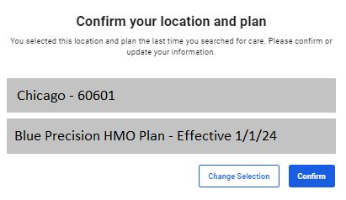
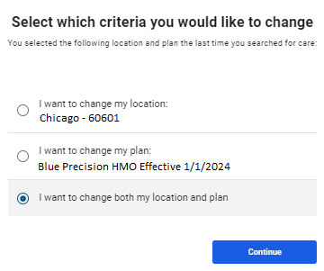
MG/PCP Changes
Searching for MyBlue Plus POS Providers
Start your search by navigating to the BCBSIL.COM public site, Click Find Care then select Find a Doctor or Hospital
Scroll down to the Basic Guest Search section and click the Search for Doctors as a Guest link
On the Confirm your Location and Plan page, click the Change Selection button
On the next page select the I want to change both radial button and click Continue.
Notes:
Click for Animations, some Animations drive themselves...

Slide 12
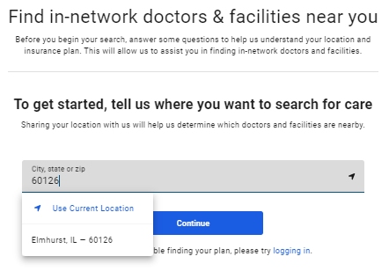
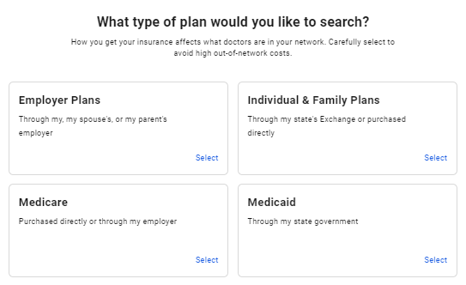
MG/PCP Changes
Searching for MyBlue Plus POS Providers
On the next page, enter the zip code for the member, select it from the drop down and click Continue.
Next, click the Individual & Family Plans tile.
Notes:
Click for Animations, some Animations drive themselves...

Slide 13
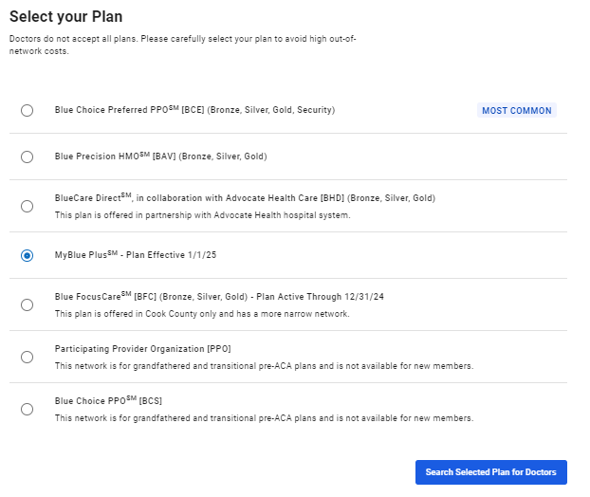
MG/PCP Changes
Searching for MyBlue Plus POS Providers
The page will refresh and display the Select Your Plan options.
Locate the MyBlue Plus plan option
Select the Radial button
Then click the Search Selected Plan for Doctors button.
Notes:
Click for Animations, some Animations drive themselves...

Slide 14
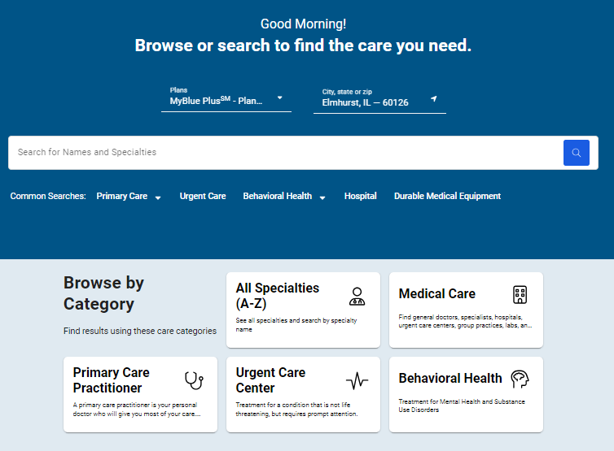
MG/PCP Changes
Searching for MyBlue Plus POS Providers
The screen will then refresh to the standard search screen that we are all familiar with.
From here, searching for a MyBlue Plus POS plan provider is the same as searching for any provider.
Notes:
Click for Animations, some Animations drive themselves...

Slide 15
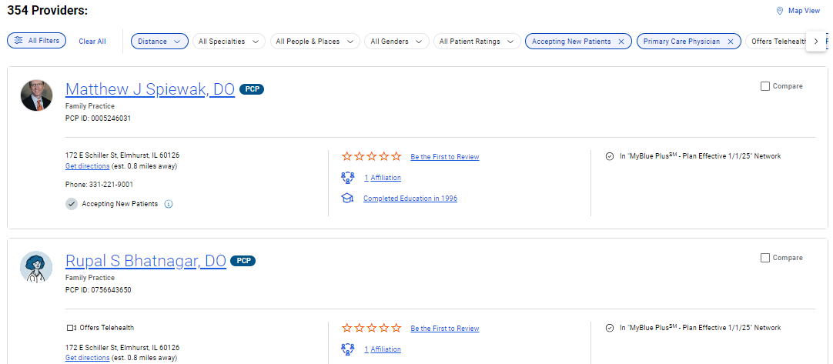
MG/PCP Changes
Searching for MyBlue Plus POS Providers
Once you have completed selecting all the search criteria and filters, you will have a familiar list of results.
You will notice that the Information card calls out participating in the MyBlue Plus POS network effective 1/1/2025.
Locate the PCP ID# and use this in ACE to assign the PCP for the member.
If you receive an error in ACE, navigate to RPI to make the update.
ACE Document Reference: RMO UPDATING MG/PCP IN ACE, Article# 000002484
Notes:
Click for Animations, some Animations drive themselves...

Slide 16
Locating ID Card Information

Slide 17
Locating ID Card Information
Patient Card in ACE
There are times, especially during OE, when members will be asking for their ID Card information before they have received the Physical ID Card.
The Self-Service option of BAM is always available to them, but if they have not registered for BAM yet or if they are not able to log in while on the phone, we can assist them by locating their ID Card information.
ID Card information can be found in multiple places in ACE, but it is recommended to use the ID Card link located in the Patient Card in ACE.
Over the next several slides, we are going to go over how to view the ID Card information from ACE using the ID Card link.
Notes:
Click for Animations...

Slide 18
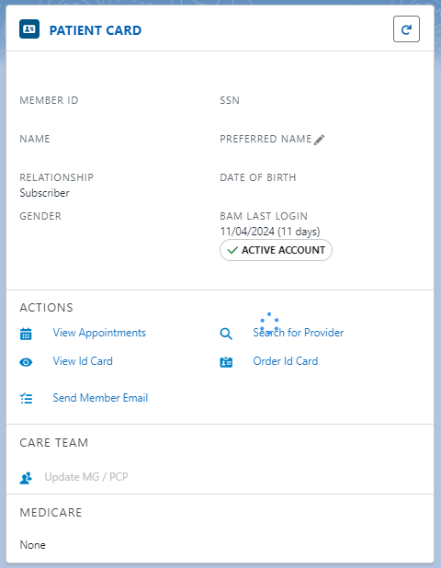
Locating ID Card Information
Patient Card in ACE
From the Holistic Member Dashboard in ACE, navigate to the Patient Card.
Once there, click on the View ID Card link.
This will launch a PDF view of the member’s ID Card.
Notes:
Click for Animations, some Animations drive themselves...

Slide 19
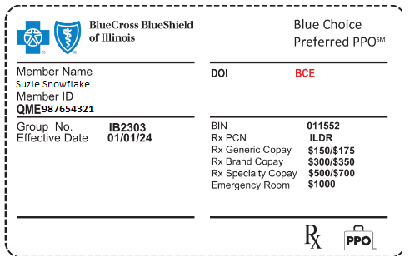
Locating ID Card Information
Patient Card in ACE
The PDF image of the ID Card will have both the front and back of the card, but for the purposes of this topic, we will only be concerned with the front of the ID Card.
As we can see, the PDF Image of the ID Card has all the information that a member would need for both medical and pharmacy related services.
On the front of the ID Card we can see:
The Member Name
The Member ID# with Alpha Prefix
The Group Number
Coverage Effective Date
The Plan Network Code
The BIN & Rx PCN
(needed for Pharmacy services)
Pharmacy Copays
Emergency Room Copay
Critical Info: When providing members with this information, be sure to include the Alpha Prefix when giving them the Member ID#.
Notes:
Click for Animations, some Animations drive themselves...

Slide 20
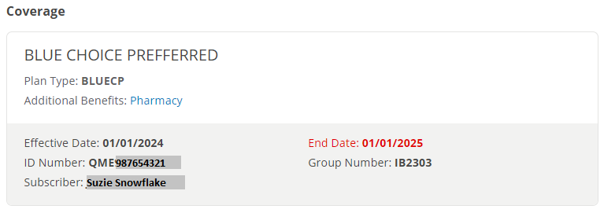
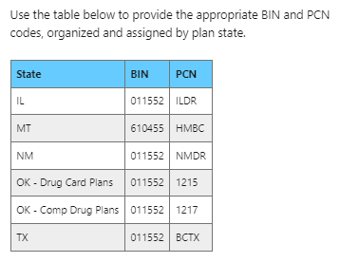
Locating ID Card Information
Patient Card in ACE
If no ID Card displays when you click the Vew ID Card link, we can find the Medical Information (ID#, Alpha Prefix and Group Number) in BAM CSR on the Dashboard Page.
The BIN and PCN information needed for Prescriptions can be found in ACE Document RMO HANDLING PRESCRIPTION INQUIRIES, Article# 000002006.
Notes:
Click for Animations, some Animations drive themselves...

Slide 21
Address Updates

Slide 22
Address Updates
Process Change
Effective immediately, we need to verify the member’s address on every call.
This change from the documented process is an attempt to make sure that we have correct addresses for our members to reduce the cost of returned mail processing due to invalid addresses.
This change does not mean that we can accept an updated address from just anyone – we still have to follow the Address Change guidelines, but if the PI (or covered Spouse) calls and advises that the address we have is not correct, follow the standard process to to update the address.
Critical Note: For On Exchange New Mexico, refer the member back to BeWellNM to have the address updated.
For On Exchange members other than On Exchange New Mexico, if there is an address change, update the Mailing Address in SLP. Then refer the member back to the Exchange to make the updates there as well.
For Off Exchange members:
If there is no Zip Code change update both the Mailing and the Physical Address in SLP.
If there is a Zip Code change, update the Mailing address in SLP and route a Case to UHUESCA for processing to update the Physical Address.
ACE Document Reference: RMO CHANGING ADDRESSES GUIDELINE, Article# 000002762
Notes:
Click for Animations, some Animations drive themselves...

Slide 23
AutoDraft

Slide 24
AutoDraft
Reminder
As a reminder, current members who are on Autodraft for their premium payments, if they are renewing for 2025, the autodraft will continue – there is nothing that they need to do to remain on autodraft.
This applies even if the member ends up renewing to a new ILB – the information for autodraft will carry over to the new ILB.
If a member needs to update/change the bank information for their autodraft, as long as the autodraft is not turned off there will be no disruption to the draft.
New members and returning members with a gap in coverage will need to set-up autodraft, this can be done with the application or after the policy has been effectuated.
If, for some reason, autodraft for a renewing member does not carry over to the new ILB, assist the member with setting it up in the MPP.
ACE Document Reference: RMO ADDING PREAUTHORIZED CHECKING (PAC, ACH) GUIDELINE (RECURRING PAYMENTS), Article# 000002738
Notes:
Click for Animations, some Animations drive themselves...

Slide 25
Key Dates

Slide 26

Key Dates Reminder
Legend
Legacy Discontinuance Mailing
Window Shopping Dates
Renewal ID Card Processing
Policy Kit Processing
You are Here...
09/25 & 09/26
Discontinuance Letters Mailed
11/01
Renewal ID Cards sent to the Vendor
10/15
Window Shopping at BeWellNM begins
11/18
Release New Member Policy Kits
September
October
November
December
09/20
Discontinuance Letters Printed
10/25
Window Shopping at CMS (Federal Exchange) begins
11/13 – 11/16
Policy Kit Production Verification
12/16
Release Renewal Member Policy Kits
10/01
Discontinuance Letters In-Home
Critical Note: Items in Grey have already happened
Notes:
Click for Animations, some Animations drive themselves...

Slide 27
Key Dates Reminder
Legend
60-Day Renewal Letters Mailed
BAR File Processing Dates
Open Enrollment Date
You are Here...
11/01
OE Begins
All States
12/15
OE Ends for
Off Ex NM
12/15
Last Day to apply for 1/1 coverage
11/11 – 11/15
Off Exchange BAR File Processing
10/22– 10/25
Initial Mailing Montana
New Mexico
Oklahoma
01/15
OE Ends for
All States
11/25 – 11/29
CMS/BeWellNM BAR File Processing
Wave 2
October
November
December
January
10/17 – 10/22
Initial Mailing Illinois & Texas
10/28
Catch up #1
All States
11/25
Catch up #2
All States
12/16 – 12/20
CMS/BeWellNM BAR File Processing
Wave 3
10/15 – 10/31
CMS/BeWellNM BAR File Processing
Wave 1
01/02
Catch up #3
All States
Critical Note: Items in Grey have already happened
Critical Note: The initial mailing of the 60-day renewal letter has an In-Home target date of 11/01.
Any member who is missed in the Initial Mailing will receive their letter in one of the Catch up Mailings.
Notes:
Click for Animations, some Animations drive themselves...

Slide 28
Questions?

Slide 29
“To support a positive coaching and learning environment for our staff, so that they are best equipped to help our members.”
Thank you from your
Service Support Team:
Tiffany Woodruff
Domonique Chavez
Deanna Covington
Geralyn Pantano
Jennifer Hunt
Kelly Corcoran
Keydra Curry
Mickey DeVolder
Salem Lundy-Sanchez
Sunny Brown
Travis Beeley
CSI Survey Link
Questions/Suggestions:
Refer to Job Aid Coord vs DS vs CDS Mailbox on RCS SharePoint page for assistance with what to send.

